Slide 1





EMPLOYEE CHURN PREDICTION
Team : NAVEEN CLITON A Guide: P.RAJA
naveencliton9138@gmail.com (Master trainer edunet foundation)
912421114305
1A0E77C91FE6AEDB0914C7FF8E0899F5 (aut2291240008)
Disclaimer: The content is curated for educational purposes only.
Notes:
Slides: Prepare a short slide deck (10-12 slides) summarizing the project objectives, methodology, and key results.

Slide 2
OUTLINE
Abstract of the Project
Problem Statement
Proposed Solution
System Architecture
Live Demo of the Project
Embedded Video of Project
Conclusion
Future Scope

Slide 3
Abstract
The application of AI in medical imaging analysis has revolutionized the field of radiology by enabling automated diagnosis and improved interpretation of medical images such as X-rays, MRIs, and CT scans. This technology is utilized by leading healthcare companies to enhance diagnostic accuracy, streamline workflows, and prioritize critical cases. Despite its significant potential, challenges remain in terms of data quality, biases, and integrating diverse data sources for comprehensive analysis. Future research aims to address these limitations by incorporating advanced machine learning techniques, longitudinal studies, and additional data such as genetic and treatment information to further improve patient outcomes and the precision of medical imaging.

Slide 4
Problem Statement
The objective of the Medical Imaging Analysis project is to develop advanced AI models that automate the diagnosis and analysis of medical images, such as X-rays and MRIs. These models aim to accurately detect abnormalities, thereby enhancing the diagnostic capabilities of radiologists and facilitating more efficient interpretations. By leveraging machine learning and deep learning techniques, this project seeks to improve diagnostic accuracy, reduce processing time, and support clinical decision-making, ultimately leading to better patient outcomes and streamlined healthcare delivery.

Slide 5
Proposed Solution
The proposed solution involves developing an AI-based system for automated medical imaging analysis to assist radiologists in diagnosing and interpreting medical images more accurately and efficiently. This system would utilize advanced deep learning algorithms to detect abnormalities in imaging modalities such as X-rays, MRIs, and CT scans, highlighting potential issues for further review by clinicians. By integrating diverse datasets, including imaging data, patient demographics, and clinical history, the solution aims to provide a comprehensive analysis that supports personalized treatment decisions. The system would also incorporate continuous learning capabilities to improve diagnostic performance over time as more data becomes available, ultimately enhancing patient outcomes and optimizing radiology workflows.

Slide 6
System Architecture
Hardware Requirements:
1. Processor (CPU):Multi-core processors like Intel i7/i9 or AMD Ryzen 7/9 for handling complex computations and parallel processing tasks efficiently.
2. Memory (RAM):At least 32 GB of RAM, preferably 64 GB or more, to manage large datasets and support smooth multitasking.
3. Storage:Fast SSDs (Solid State Drives) with a minimum of 1 TB capacity for storing datasets, models, and temporary files. NVMe drives are preferred for faster data access.)
4. Graphics Processing Unit (GPU):High-end GPUs such as NVIDIA RTX 30 series, A100, or Tesla series for accelerated deep learning model training and real-time inference.
5. Network:High-speed Ethernet (1 Gbps or higher) for efficient data transfer, especially when accessing imaging data from remote servers or cloud storage.

Slide 7
System requirement
Operating System:
Compatible with Windows 10/11, Linux (e.g., Ubuntu 20.04 or later), or macOS, with Linux often preferred for better compatibility with AI frameworks and performance.
Programming Languages:
Python is essential for developing AI models, supported by libraries such as TensorFlow, PyTorch, and OpenCV.
R or MATLAB can be used for additional statistical analysis and data visualization.
AI and Machine Learning Libraries:
TensorFlow or PyTorch for deep learning model development and training.
Scikit-learn for traditional machine learning algorithms.
Keras for simplified deep learning model creation.
Medical Imaging Libraries:
SimpleITK or Pydicom for handling medical imaging formats like DICOM.
Numpy and Scipy for numerical computations and image processing tasks.
Data Management Software:
Database management systems like MySQL, PostgreSQL, or MongoDB for storing medical image metadata and patient data.
Cloud storage solutions or local file systems for storing large imaging datasets.

Slide 8
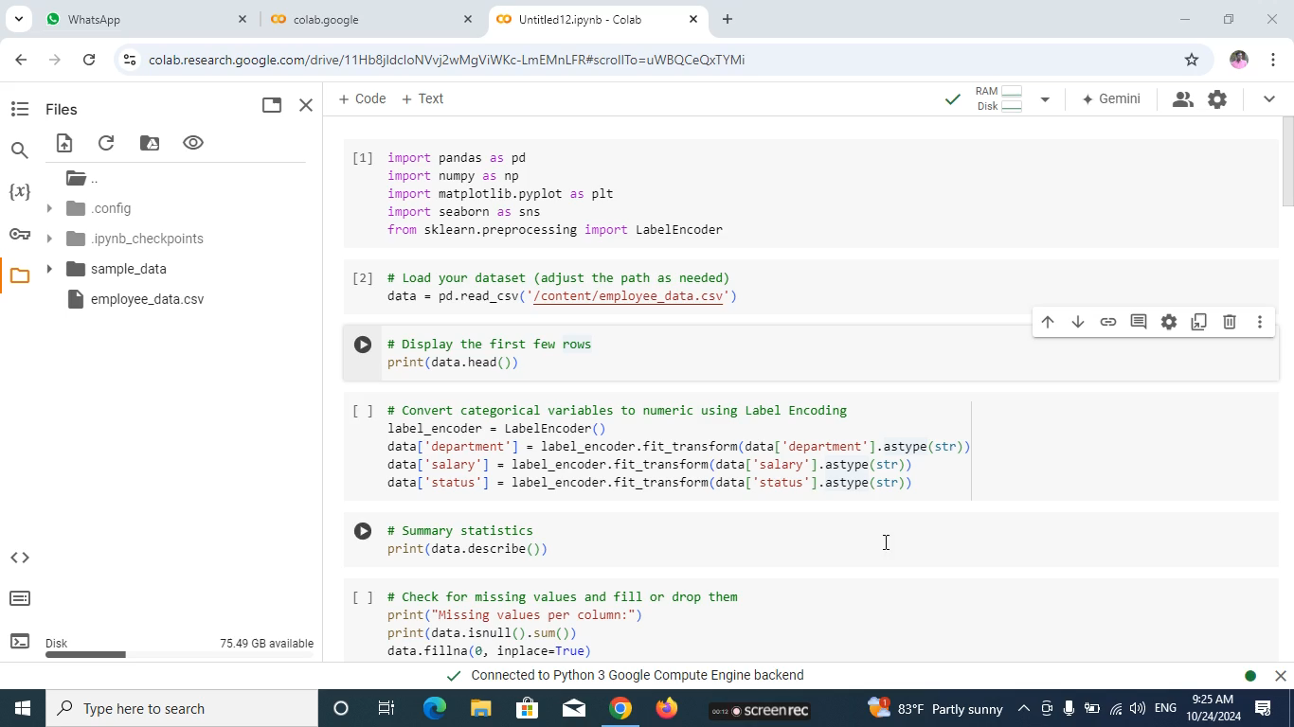
Live Demo of Project
https://drive.google.com/file/d/1MPNBglumlAsPee1DCFTZSsRvzehcbBWa/view?usp=drive_link

Slide 9
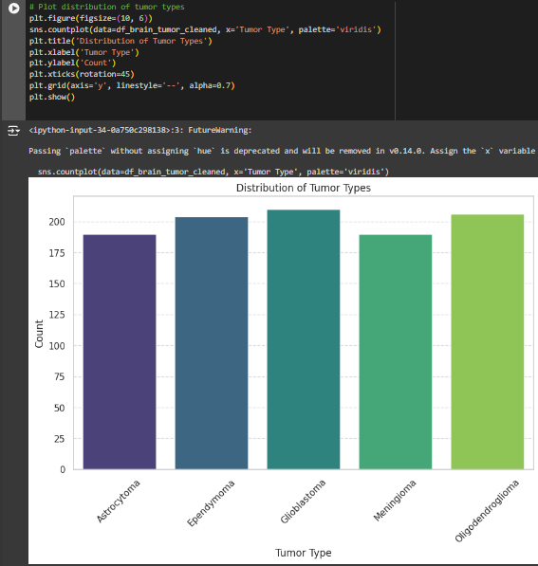
Video of Project Demo
PLOT DISTRIBUTION OF TURMOR TYPES

Slide 10
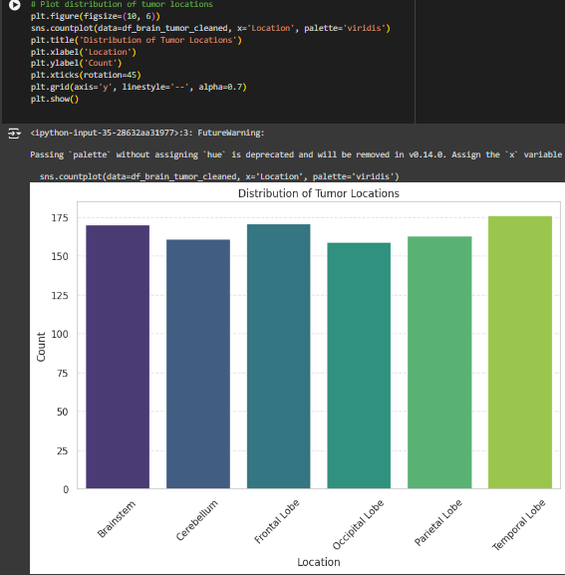
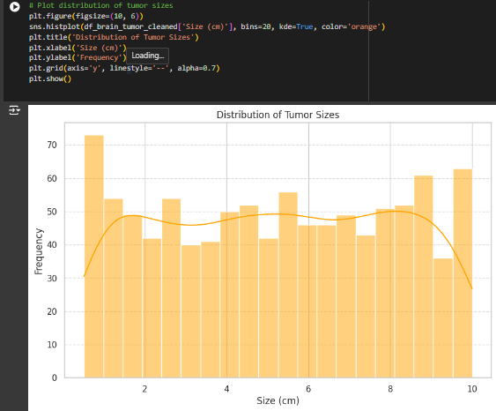
CORRECTION MATRIX ELBOW METHOD OPTIONAL K

Slide 11
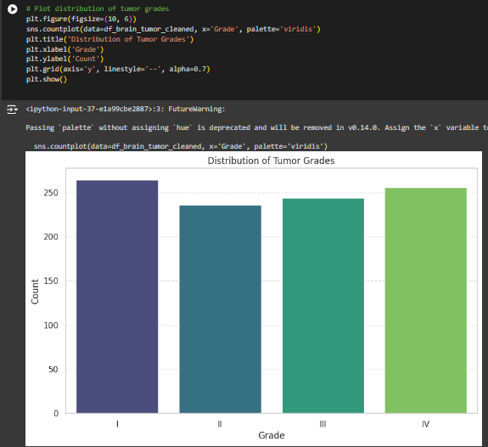
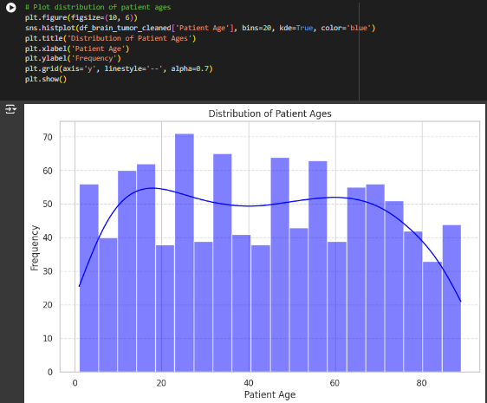
ROC CURVE

Slide 12
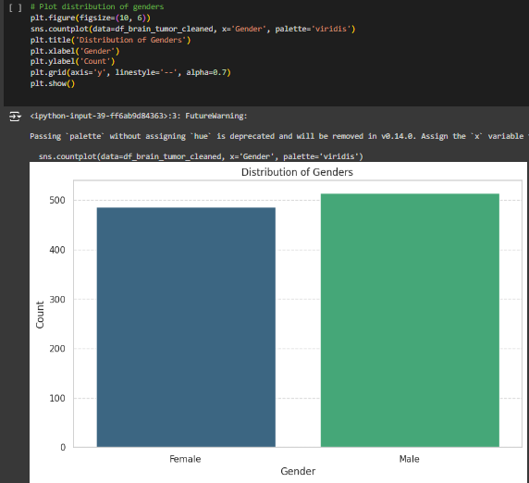
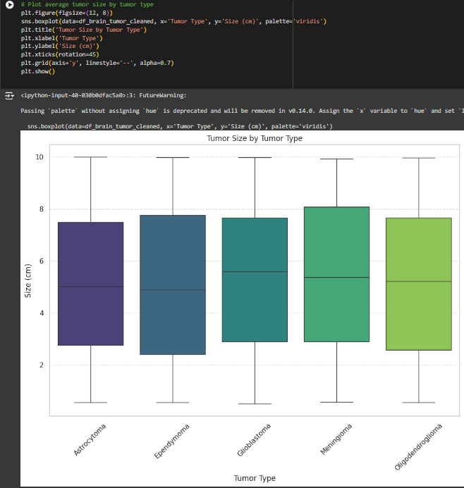

Slide 13
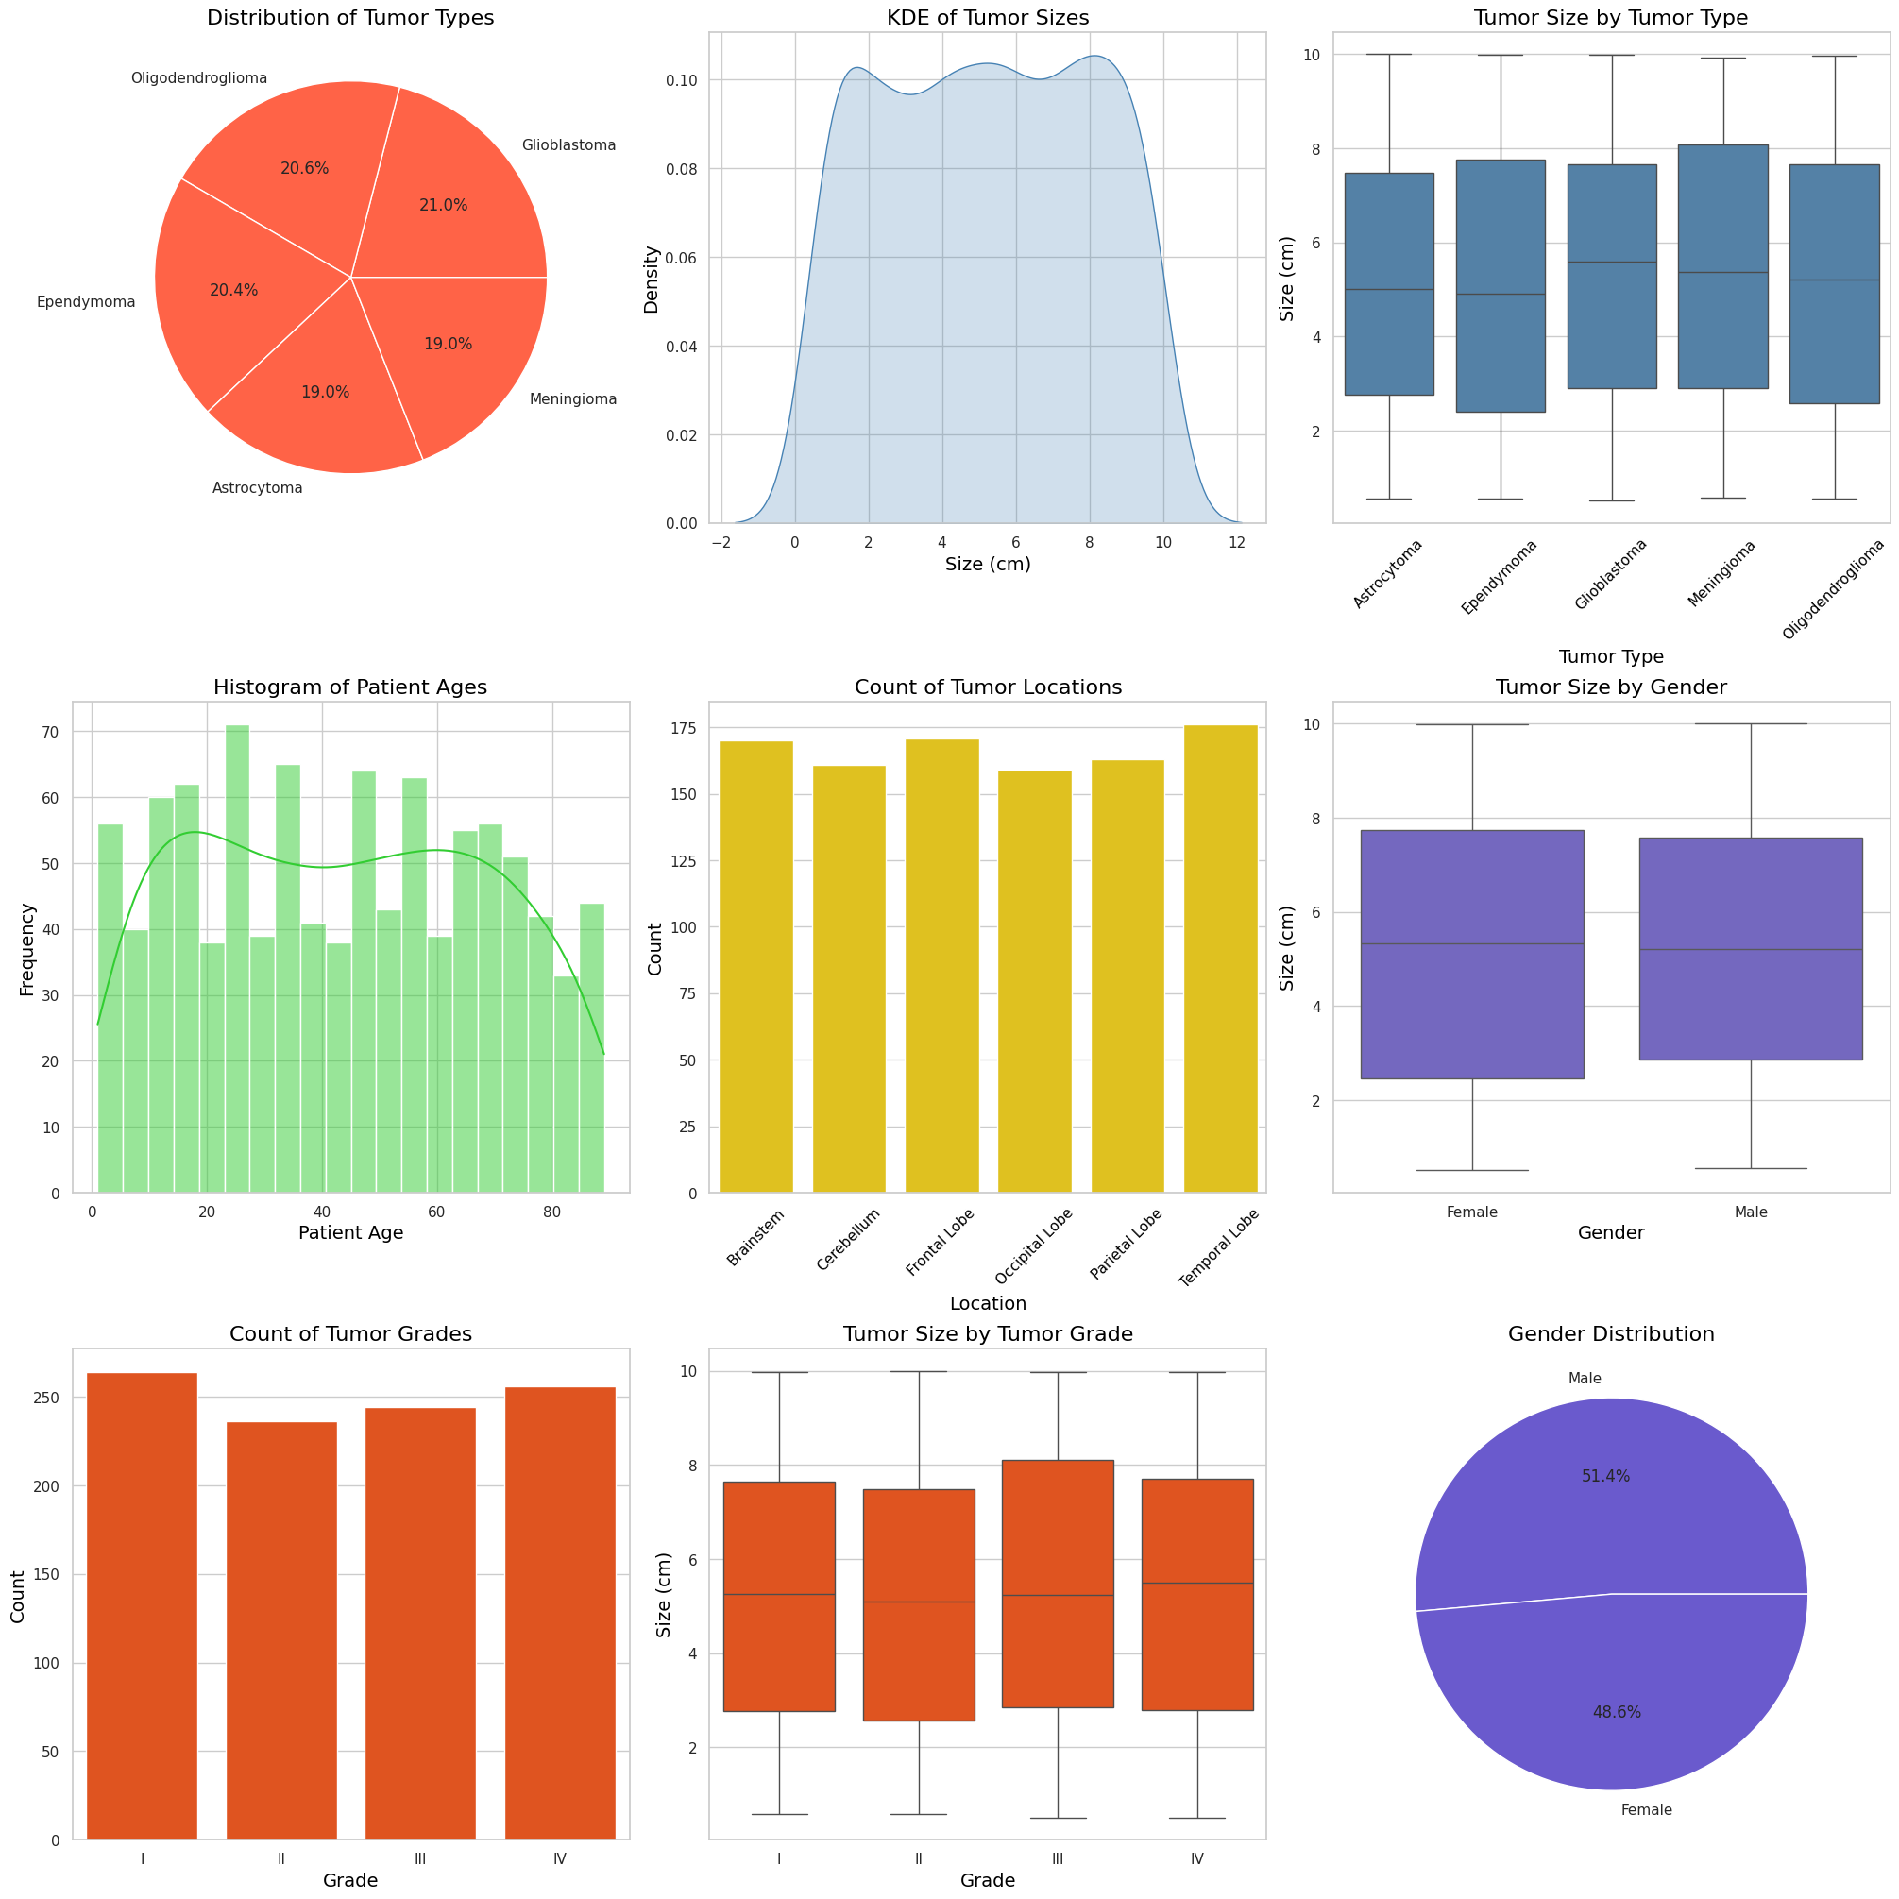

Slide 14
Conclusion
In conclusion, the analysis of the brain tumor dataset provides valuable insights into the distribution and characteristics of various tumor types, sizes, and their demographic associations. The visualizations generated highlight key trends that can inform clinical decision-making and enhance understanding of tumor behavior. Despite certain limitations, such as potential biases and the lack of longitudinal data, the findings serve as a foundation for future research. By leveraging advanced analytical techniques and integrating diverse data sources, we can further improve diagnostic accuracy and patient care. Ultimately, this work underscores the importance of data-driven approaches in the field of medical imaging and oncology.

Slide 15
Future Scope
Future work should focus on conducting longitudinal studies to track tumor progression and patient outcomes over time, providing deeper insights into the dynamics of brain tumors. Integrating additional data sources, such as genetic information and treatment histories, will enhance the analysis and understanding of tumor characteristics and patient responses. Implementing advanced machine learning algorithms for predictive modeling could improve diagnostic accuracy and identify potential risk factors. Additionally, exploring imaging data alongside demographic information will create a more comprehensive model for tumor analysis. Finally, collaboration with medical professionals is essential to validate findings and ensure their practical applicability in clinical settings.

Slide 16
Thank you!
Notes:
thank you very much for joining this PPT, keep learning.
16

